Slide 1
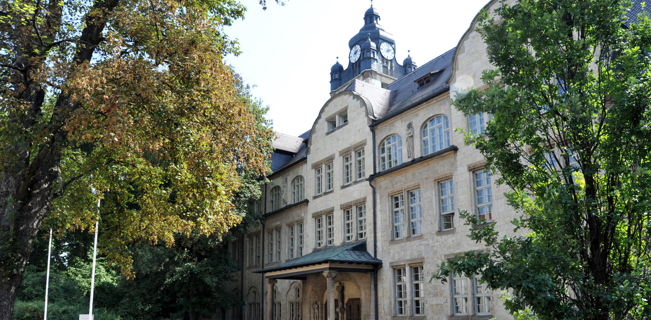
A Study of the Polarization Dependency of Raman Spectra
Jonas Eichhorn
Jonas Eichhorn

Slide 2
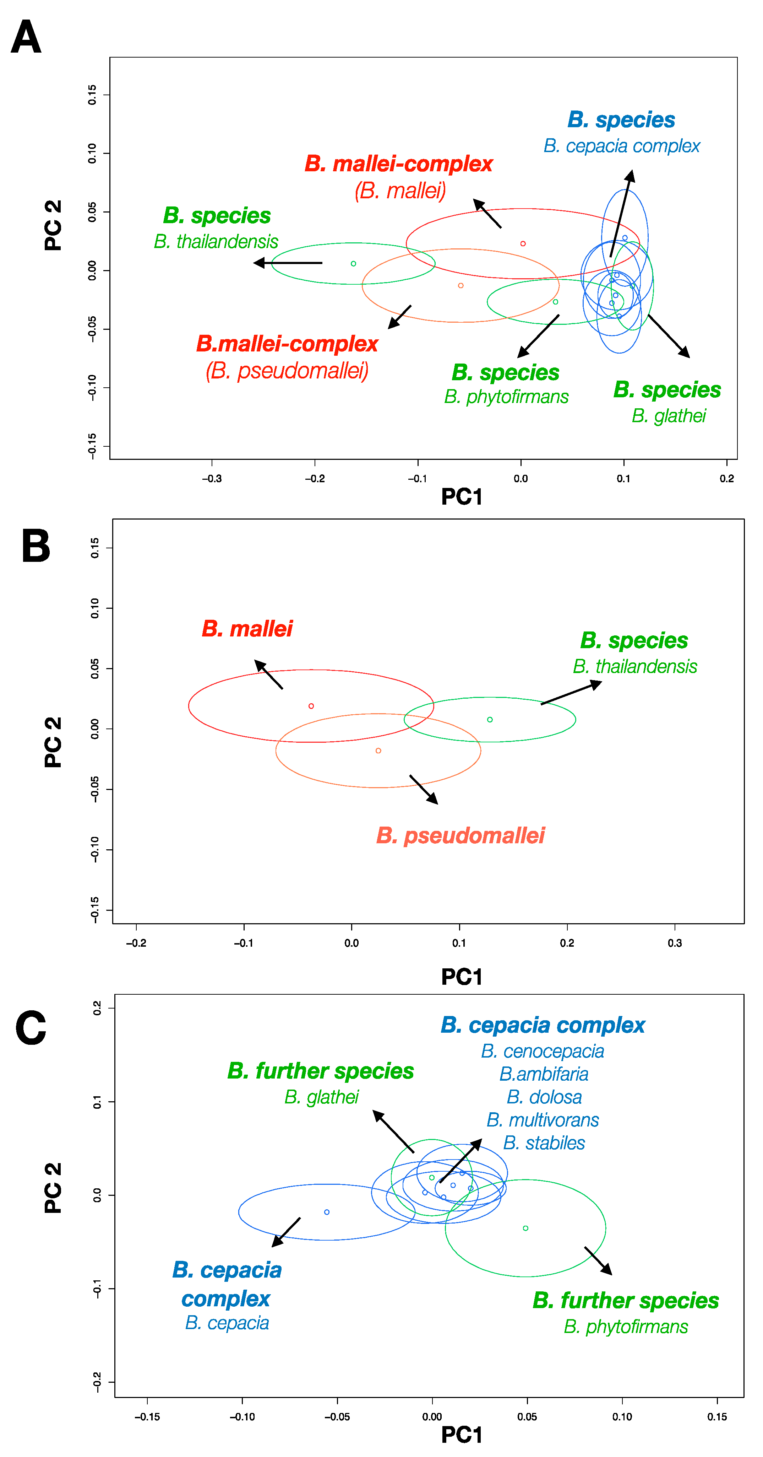
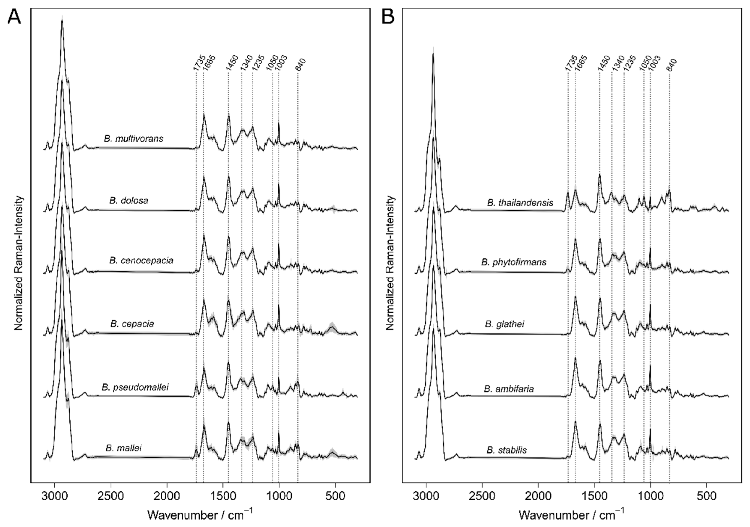
Biological Applications of Raman Spectroscopy
…
Complex Spectra
Machine Learning
Sensitive Model
A.A. Moawad, A. Silge, et. al., Molecules, 24, 24, 4516 (2019).
Jonas Eichhorn
Notes:
Task:
Distinguish very similar spectra of related bacteria
Solution:
Machine Learning can identify small differences in spectra
Problem:
Model must be very sensitive to distinguish bacteria
Different Raman spectrometers generate slighlty different spectra
Model can‘t distinguish influence of spectrometer and changes caused by different samples
Question of the thesis:
Wide-spread clinical application is difficult (model transfer methods, repairs/replacements, data sharing)
Is the polarisation of the exciting laser one reason why we can‘t compare Raman spectra from different Raman spectrometers?

Slide 3
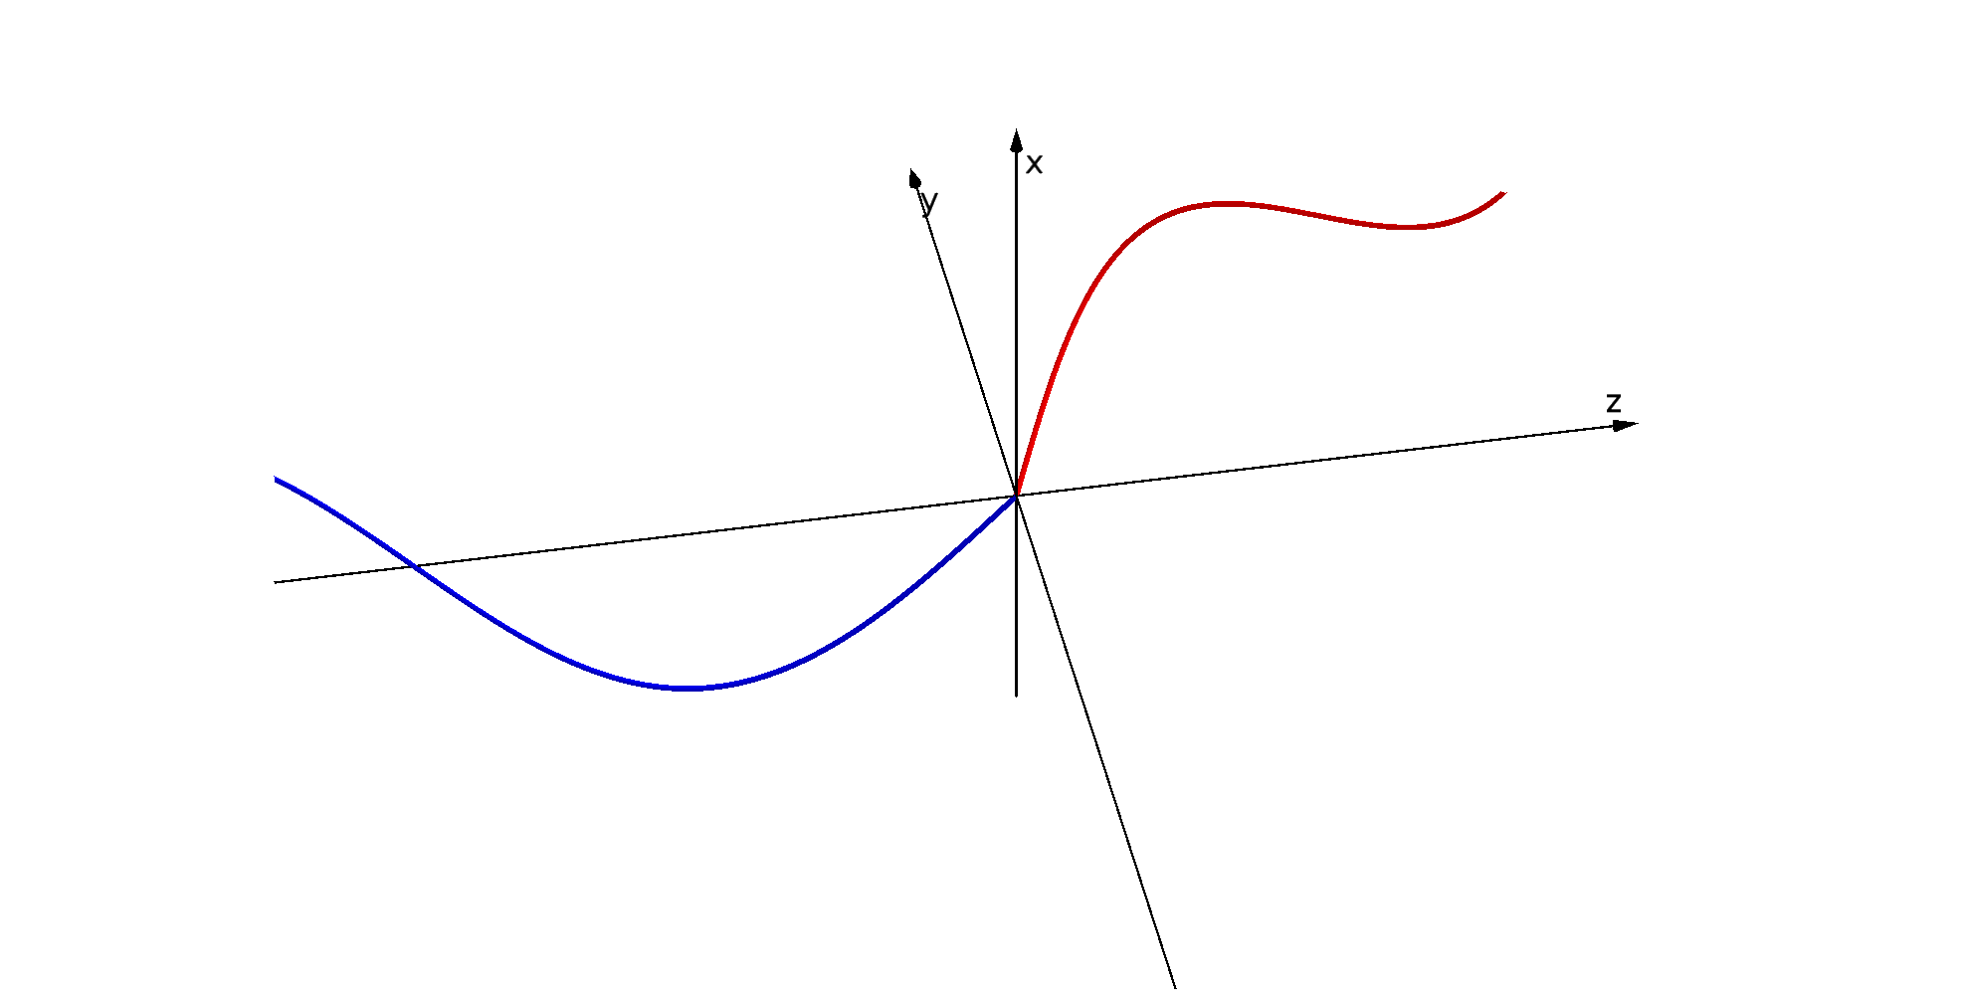
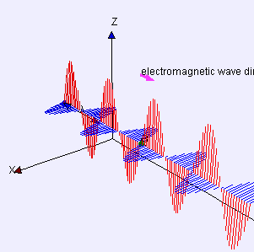
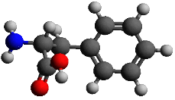
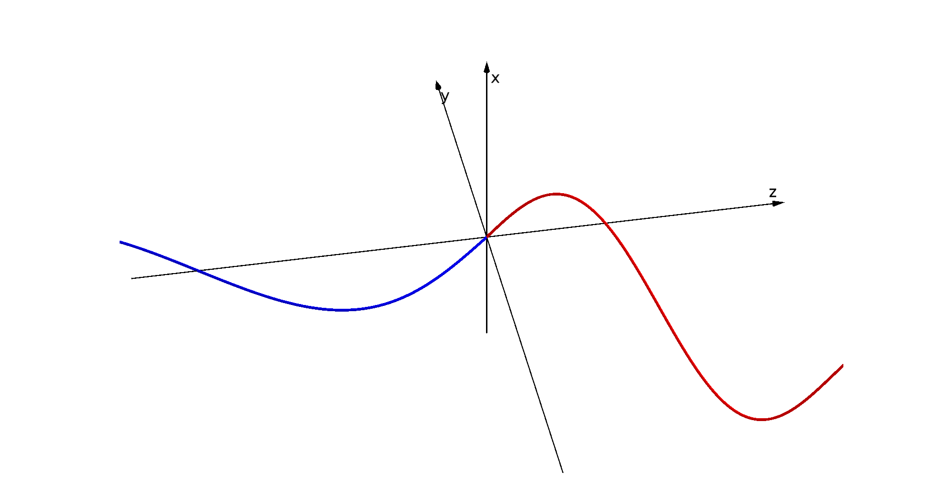
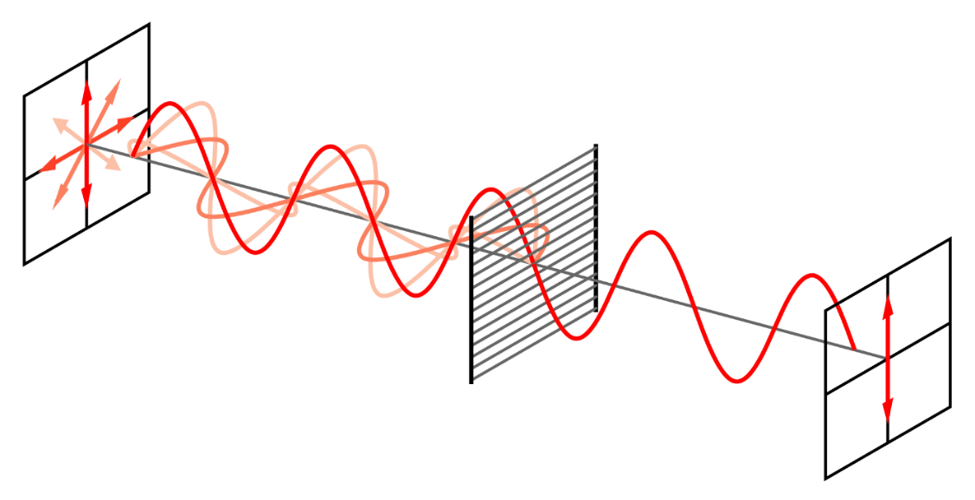
Polarisation Dependency in Raman
Jonas Eichhorn
Notes:
EM-Wave:
Electric and a Magnetic component
For simplification: Only the electric component will be discussed
Polarisation:
Looking at the electrical component: Oscillation can happen in all directions -> unpolarised light
Oscillating electrical fields can be correlated -> polarised light
Circular polarisation possible, but not relevant for this
Notation:
Electromagnetic wave as oscillating e-field vector
Polarisation as 4-D Stokes vector
Raman Scattering:
Molecules have anisotropic polarisabilities -> anisotropic changes of polarisability
Polarisation of the exciting wave influences: polarisation of scattered light and scattering efficience

Slide 4
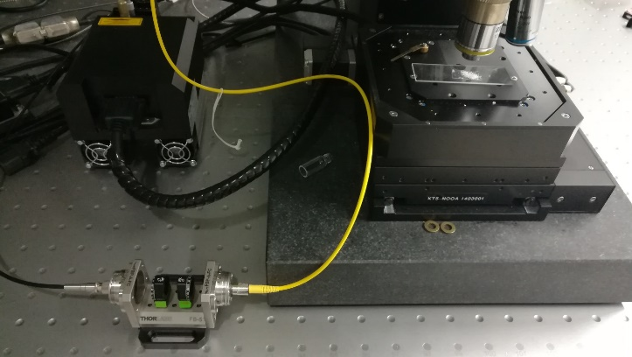
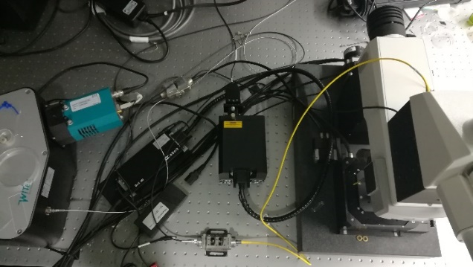
Polarisation Dependent Behaviour
Characterise
Spectrograph
Characterise
Fiber
Characterise Fiber
Manipulate Polarisation
laser
sample
laser
detector and
spectrograph
wave plate
fiberbench
microscope
with sample
fiberbench
Jonas Eichhorn
Notes:
Why should we worry about polarisation dependency of Raman scattering?
Fiber-coupled Raman microscope was used
Spectrometer has polarisation sensitive optical grating
Reflectance and polarisation of reflected light depends on intial state of polarisation
Furthermore optical fibers have influence on polarisation
Idea: Simulate different Raman spectrometer with one device
Characterise polarisation dependency of fibers and spectrograph
Manipulate state of polarisation with optical element -> rotate plane of polarisation
Fiberbench placed between laser and microscope

Slide 5
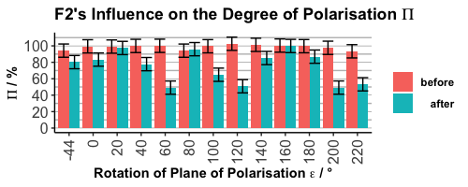
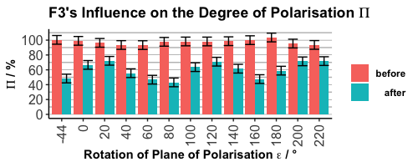
Characterisation of Optical Fibers: Degree of Polarisation
Degree of polarisation depends on the polarisation!
Jonas Eichhorn
Notes:
All optical fibers reduce the degree of polarisation
Complex polarisation dependent behaviour
MM-Fiber F3 seems to have periodic dependency
Depolarisation should decrease the magnitude of polarisation dependent effects
This makes it difficult to measure the effect

Slide 6
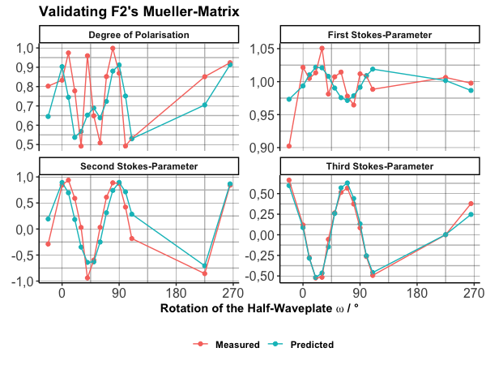
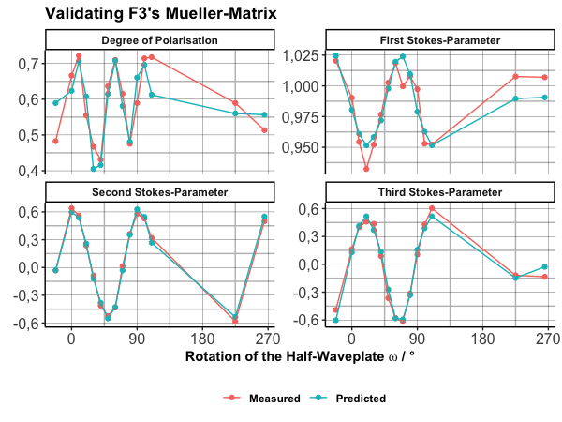
Characterisation of Optical Fibers: Mueller matrix
Fiber
Fiber
Laser
Jonas Eichhorn
Notes:
Describe optical fibers mathematically:
Why the math? -> simulate and validate experiments later on
Applying 4x4 Mueller matrix onto Stokes vector describes light-matter interaction
Mueller matrix describes influence of fiber on state of polarisation
How to compute Mueller matrix?
Measure Stokes vectors before and after fiber
Build non-linear model to fit the data with the matrix elements
Result:
Matrix of SM-fiber describes the changing stokes vectors good
Degree of polarisation is poorly described
Matrix can‘t be used, instead only characterised states of polarisation will be used in later experiments
MM-fiber is described very good by Mueller matrix. Stokes parameter and degree of polarisation are fitted well

Slide 7
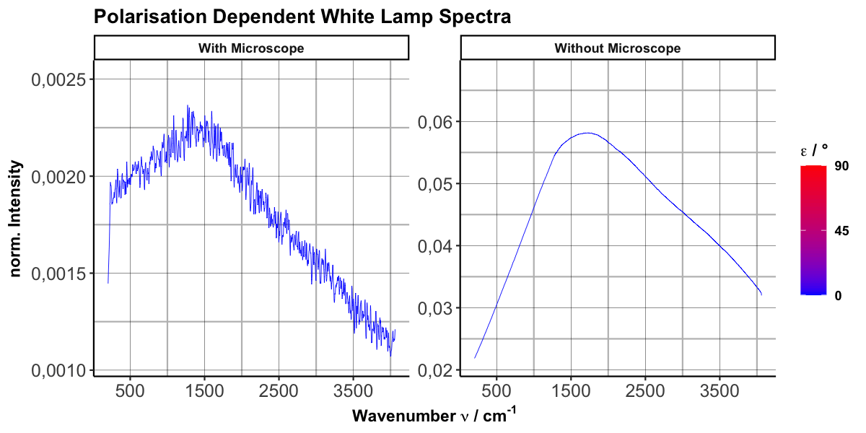
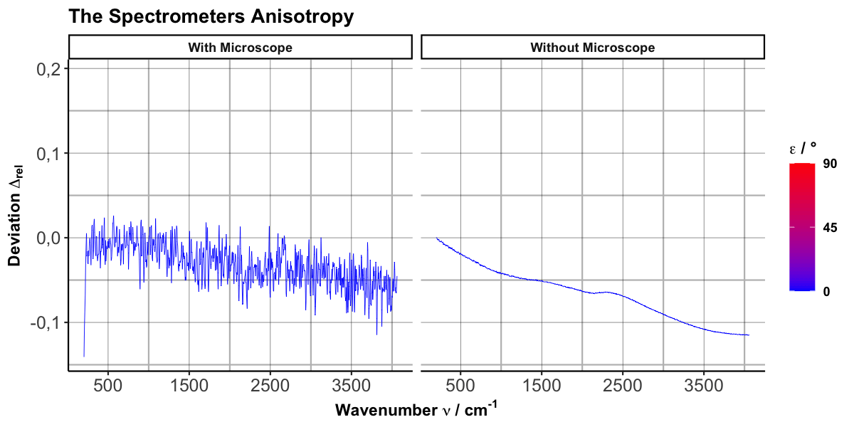
Characterisation of the Spectrometer: White Lamp Spectra
Complex Polarisation Dependent Behaviour
Jonas Eichhorn
Notes:
White Lamp Spectra
Spectrometer was characterised with linear polarised white lamp
Characterisation with and without microscope & optical fiber
The sensitivity of the detector depends on the polarisation
Optical fiber and microscope decrease intensity and introduce artifacts
Difference Spectra
The polarisation dependency increases with the wavenumber
Change in polarisation sensitivity is stepwise, non linear and polarisation dependent

Slide 8
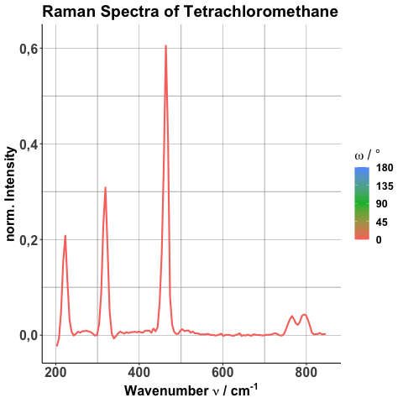
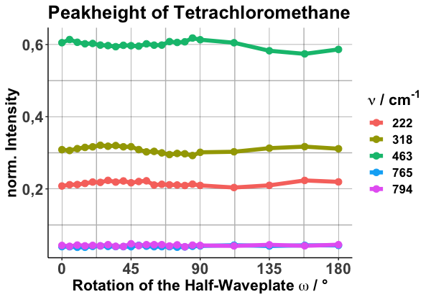
Characterisation of the Spectrometer: CCl₄
Jonas Eichhorn
Notes:
Characterise spectrometer with Tetra
Why Tetra? -> Good scatterer and high polarisation dependence
Result
Signal strength changes periodically with the rotation of the plane of polarisation
peak height ratio changes -> potential problem for analysis

Slide 9


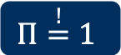
Raman-Mueller-Transformation: A Reminder
F2 → $Π≪1$
QC Calculation
Raman Tensor
Mueller Matrix
$$Π\overset{!}{=}1$$
Jonas Eichhorn
Notes:
Derived in previous talk
Fully and linear polarised light was assumed
Characterisation shows: The experiment does not satisfy the assumptions.

Slide 10
Generalising the Derivation
Linear Combination
Integration
Apply Raman-Mueller-Matrix
Jonas Eichhorn
Notes:
(Point at formula when you talk!)
Express the linear Stokes vector as linear combination of a totally polarised and a totally unpolarised part.

Slide 11
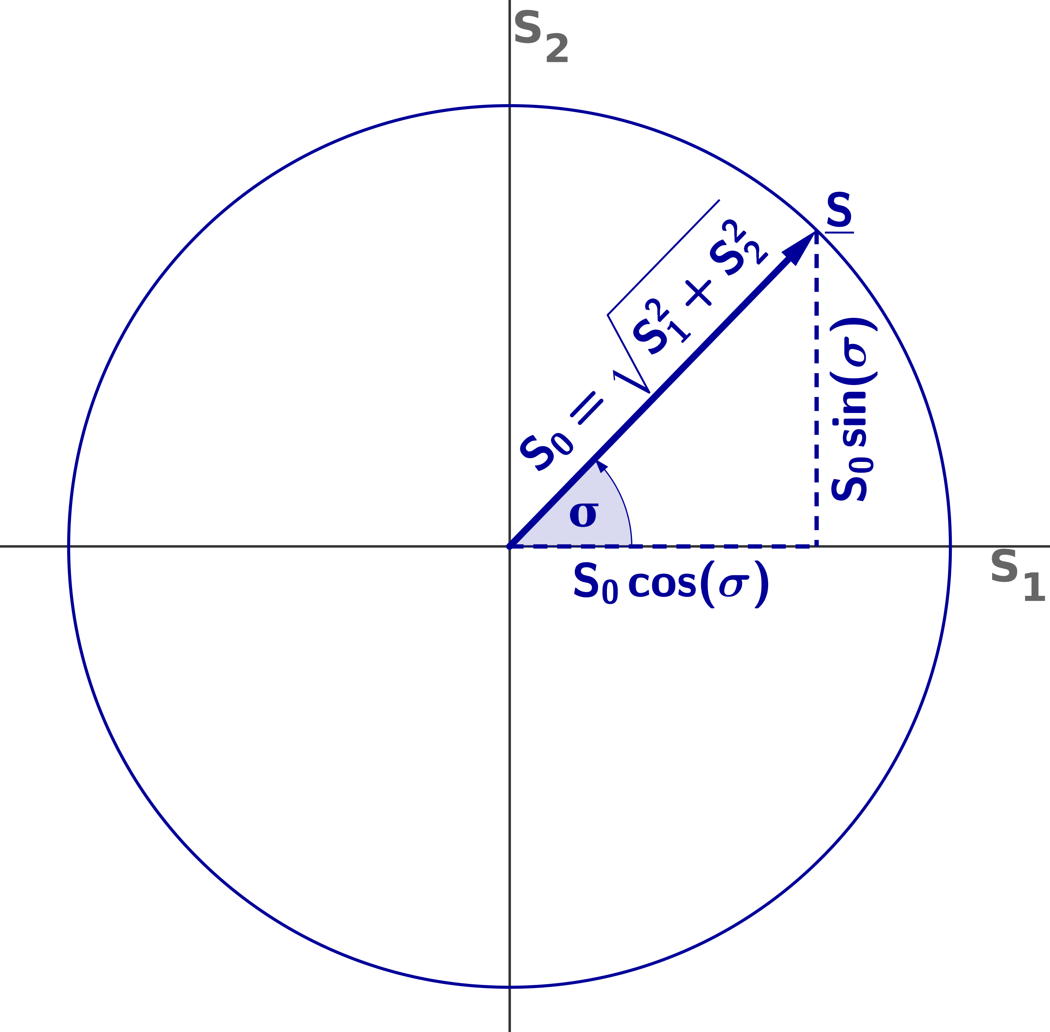
Generalising the Derivation
Linear Combination
Integration
Apply Raman-Mueller-Matrix
Jonas Eichhorn
Notes:
Express the Stokes vector of the unpolarised part with polarised Stokes vectors.
Use all totally linear polarised Stokes vectors
Combination of all vectors yields unpolarised light
Expressed as Integral over polar Stokes parameter

Slide 12
Generalising the Derivation
Linear Combination
Integration
Apply Raman-Mueller-Matrix
Jonas Eichhorn
Notes:
Applying Mueller matrix onto linear combination and partially polarised Stokes vector are equivalent
Raman-Mueller-Transformation can be applyed for partially polarised light

Slide 13
Simulation of Raman Spectra: CCl₄
Non-Linear Model
Jonas Eichhorn
Notes:
Simulate Detector response D for validating Raman spectra of tetra
Assumption: detector has one sensitive optical axis
I_y is the lights intensity along the sensitive optical axis
I_x is the lights intensity perpendicular to the sensitive optical axis
Input and Output
Intensities are computed from Stokes vectors
D is derived from measured Raman spectra
Stokes parameter is computed from characterised Stokes vector, Raman-Mueller-matrix and Mueller matrix of the MM-fiber
A describes the anisotropy of the detector
A is computed with non-linear model
A=1 is isotropic detector, A>1 y-axis is the sensitive optical axis

Slide 14
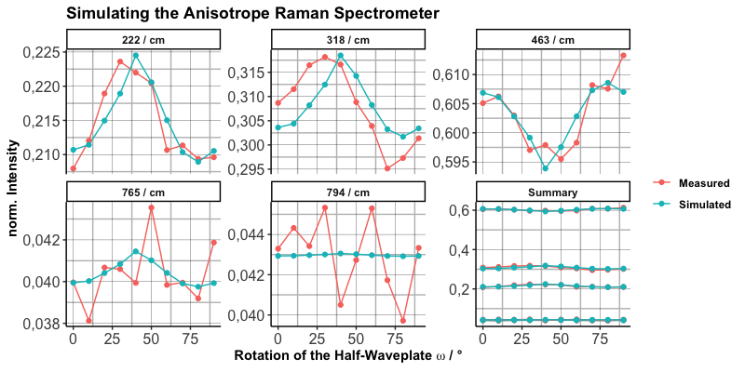



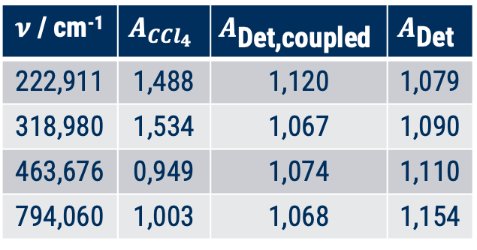
Simulation of Raman Spectra: CCl₄
$ν$ / cm⁻¹ | $$A_{{CCl}_{4}}$$ | $$A_{\text{Det}\text{,}\text{coupled}}$$ | $$A_{\text{Det}}$$
222,911 | 1,488 | 1,120 | 1,079
318,980 | 1,534 | 1,067 | 1,090
463,676 | 0,949 | 1,074 | 1,110
794,060 | 1,003 | 1,068 | 1,154
>
>
Why is the anisotropy to big/small?
Rayleigh Filter
Microscope
Vector Normalisation
Noise
>
<
<
<
<
Jonas Eichhorn
Notes:
Compare A derived from Tetra with A derived from white lamp spectra:
Expected: A_Det > D_Dert,coupled > A_CCl4
optical fibers depolarise -> less polarisation dependency expected
Result:
222/cm: A is bad, because Rayleight filter; Fit is good
318/cm: A is bad; Fit is good
463/cm: A is very bad; Fit is good
A<1 would mean that I_x is for only one peak more sensitive -> physics says NO
765/cm ignored because Gaussian can‘t handle combinatory vibrations
794/cm: A is good; Fit is bad, propablly because Noise?
Possible Reasons for unexpected results:
Rayleigh filter edge
Uncharacterised microscope
All spectra were normalised individually
Normalisation on polarisation independent peak would have been better, but physics says NO
Noise

Slide 15
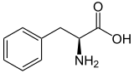
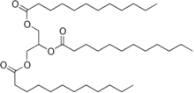
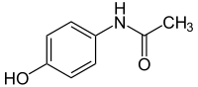
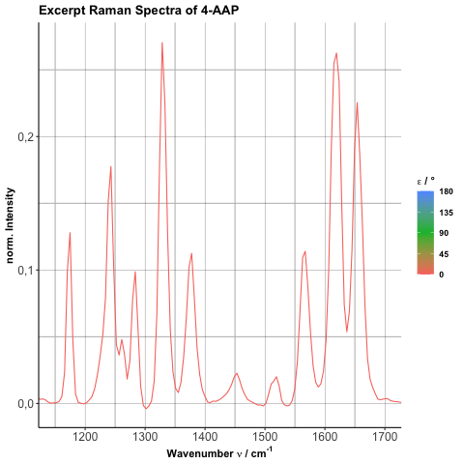
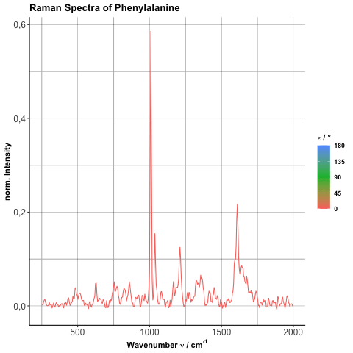
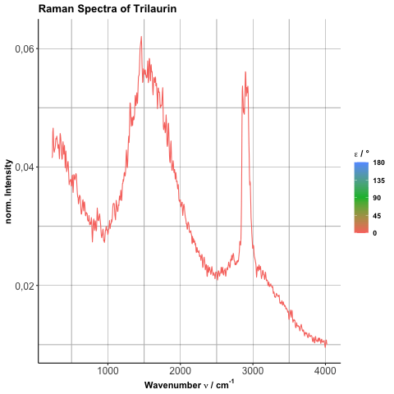
Polarisation Dependent Raman Spectra
Jonas Eichhorn
Notes:
Shortly investigate influence on biologically relevant samples:
4-AAP, Phe, Trialaurin
Polarisation dependency negelibe
Phe and Trilaurin show fiber artifacts and complex background
Analysis of spectra difficult

Slide 16


Conclusion
Quantification
Mueller formalism enbles quanti-fication of the polarisation depen-dency of a system
Optical Fibers
Optical fibers have a great influence on the state of polarisation
Spectrometers
Polarisation depen-dency is negligible
Outlook
Control of polarisation states needs to be improved
Long MM-fiber might remove pol-arisation depen-dency
Arbitrary polarisa-tion states could not be generated
Fiber-coupled Sys-tems are probably not affected
Depolarisation of the laser doesn‘t support definitive conclusions
Test free-space systems
Polarisation dependent standard samples if necessary
Jonas Eichhorn

Slide 17

Thank you
for your attention!
Jonas Eichhorn

